Slide 1
NeuroCog 1
Exam 2 Review Discussion #1
Part 2
Kiichi Yokoyama
Jaisen Lim

Slide 2
Colantuoni: Neural Induction

Slide 3
Key points
Understand concepts: organizer, induction, morphogen, gradient, competence
Gastrulation, 3 germ layers, experiments that identify the organizer
Mechanisms that direct neural induction. Factors and gradients
Stem cell systems

Slide 4
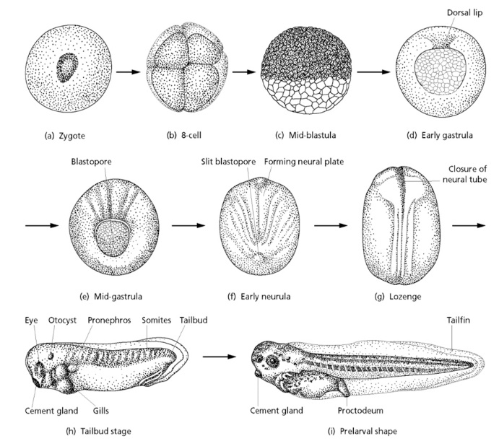
Gastrulation, organizers, morphogenetic fields, and equivalence groups
An “organizer” is a group of cells which instructs the self-organization of the embryo, determining the fate of uncommitted cells with morphogens.
A cell, or morphogenetic field of cells, is competent to respond to morphogens that determine specific cell fates.
An equivalence group defines cells with the same developmental competence.
Image - University College London – Xenopus Development:
https://www.ucl.ac.uk/~ucbzwdr/teaching/b250-99/Dale%202006.pdf
Hans Spemann Pieter Nieuwkoop Johannes Holtfreter
1869-1941 1917-1996 1901-1992

Slide 5
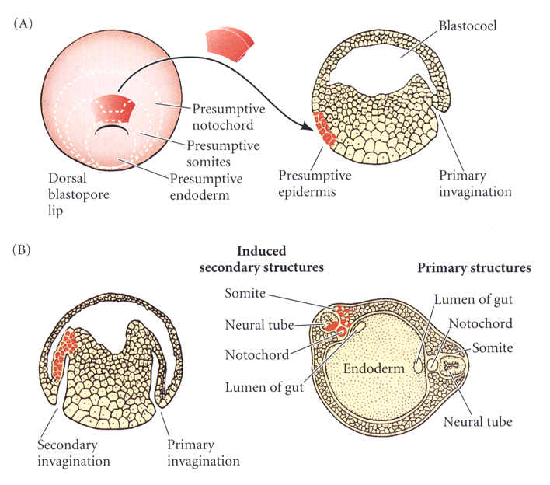
Spemann’s “organizer”
Spemann (1918) found in the salamander that transplantation of the dorsal lip of the blastopore produced an entire secondary embryonic axis. In 1924, with Mangold, using two salamander species with differently colored cells they found that cells from both animals contributed to the new axis, hence defining the inductive properties of the dorsal lip of the blastopore, calling it the “organizer”. It would take many years and the advent of modern molecular biology to decode the molecular mechanisms underlying this activity.
Gilbert – Developmental Biology
The principle of an organizer is recurrent through much of developmental biology, and guides the differentiation of pluripotent stem cell systems for the study of specific cell lineages throughout modern biomedicine.
Mangold, Spemann 1924

Slide 6
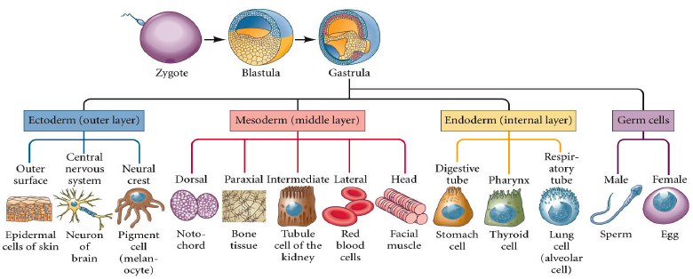
The entire new animal is generated from the three germ layers …
Gilbert – Developmental Biology
… and we can now model them ALL in vitro with pluripotent stem cell systems.
But first, let’s look at the developmental biology necessary to understand all this.

Slide 7
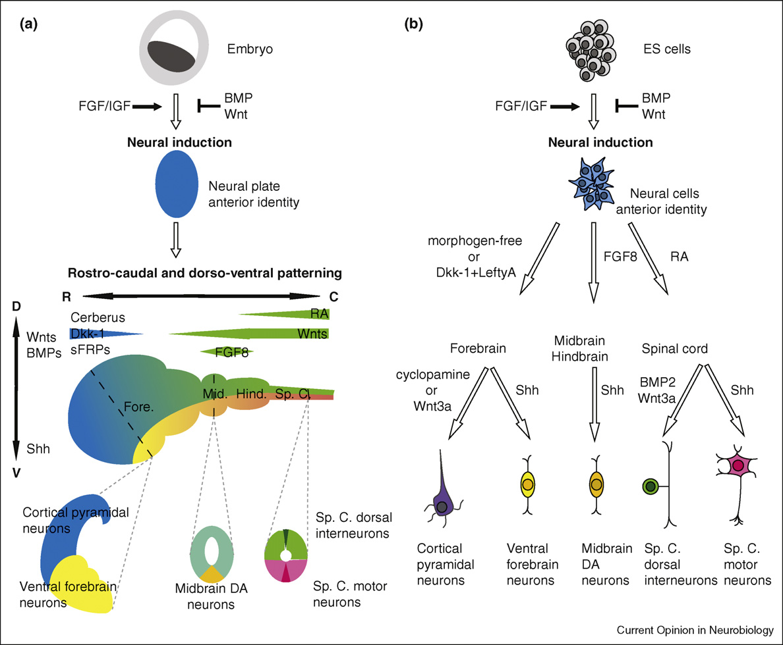
Neural induction and patterning in vivo & in vitro
Neural Induction
What, how, where, when
Anterior-Posterior Patterning
Dorsal-Ventral Patterning
What, how, when
Gaspard & Vanderhaeghen 2010

Slide 8
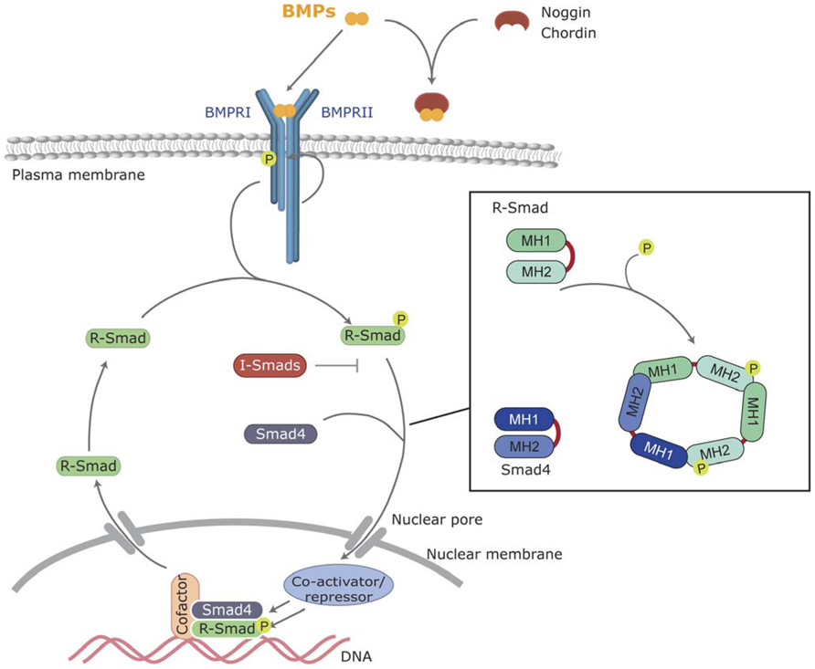
BMP signaling

Slide 9
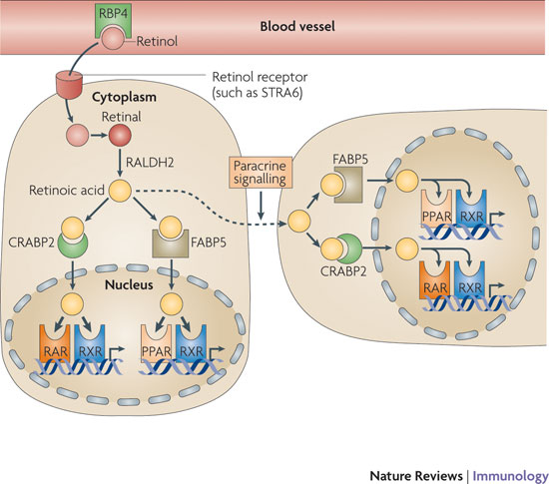
Retinoic acid signaling
Notes:
At more caudal levels of the neuraxis the secretion of retinoic acid and FGF from the mesoderm establishes distinct subdomains of the hindbrain and spinal cord

Slide 10
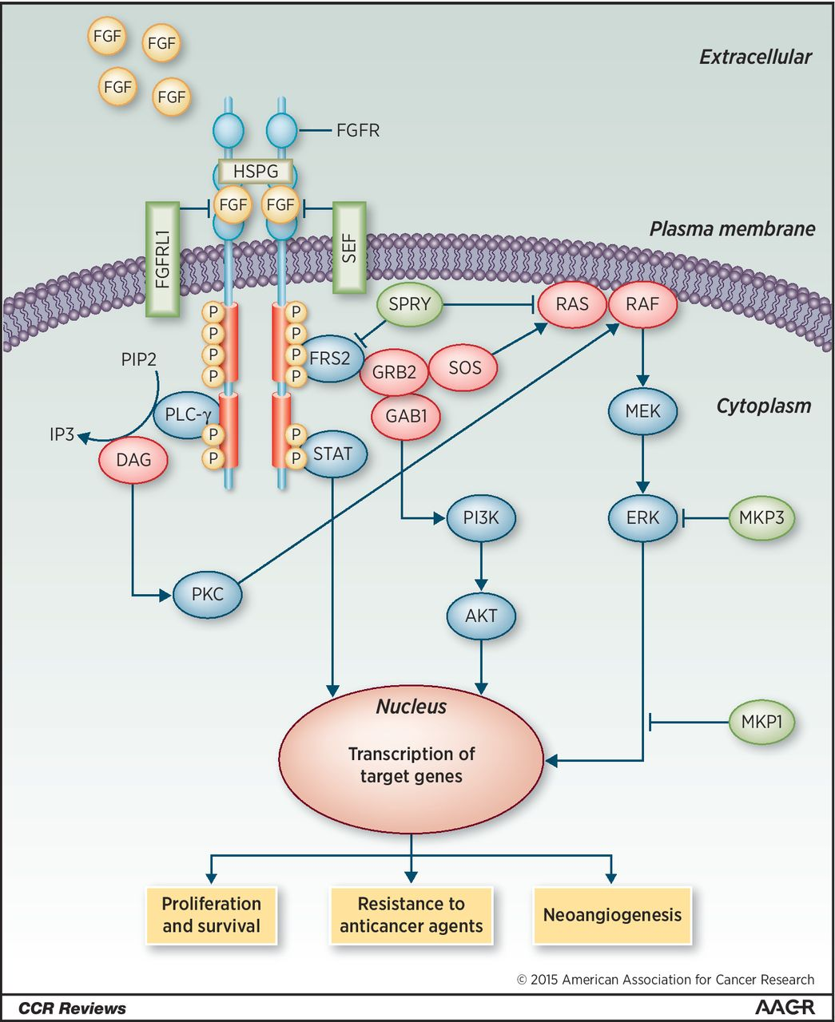
FGF signaling

Slide 11
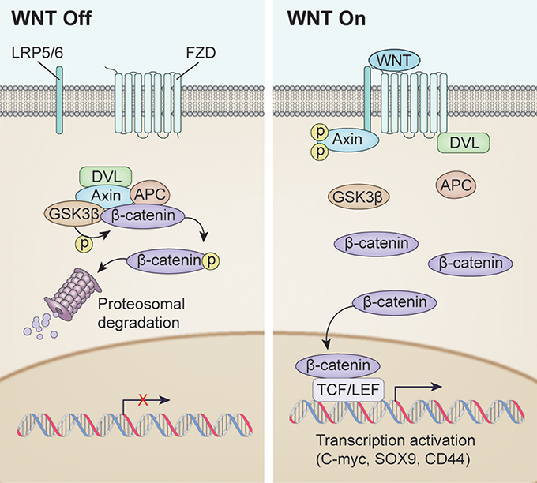
Wnt signaling

Slide 12
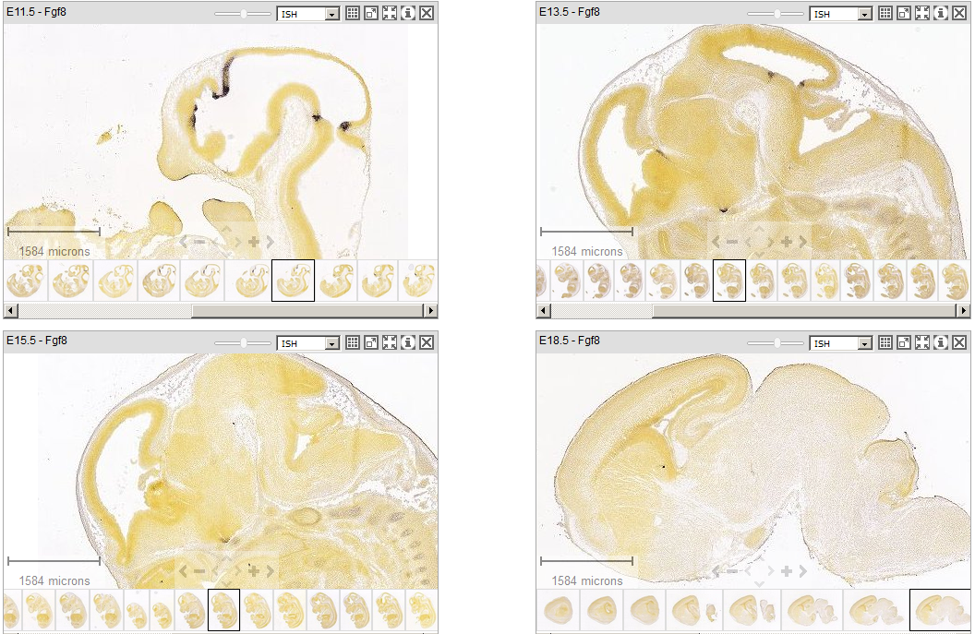
Signaling centers in the brain
isthmus (midbrain/hindbrain)
zona limitans intrathalamica (forebrain/midbrain)
anterior neural ridge (forebrain)
cortical hem (forebrain)
Fgf8 expression in mouse brain development (Allen Inst.)

Slide 13
Doetzlhofer: Neural Patterning

Slide 14
Learning objectives
at the end of the lecture, you should be able to:
  (1) describe how the neural tube and brain vesicles form.
  (2) discuss how positional information and identity is established (French flag model).
  (3) summarize the key steps of dorsal/ventral and anterior/posterior neural patterning.
  (4) name the main organizing centers and explain what their function is.

Slide 15
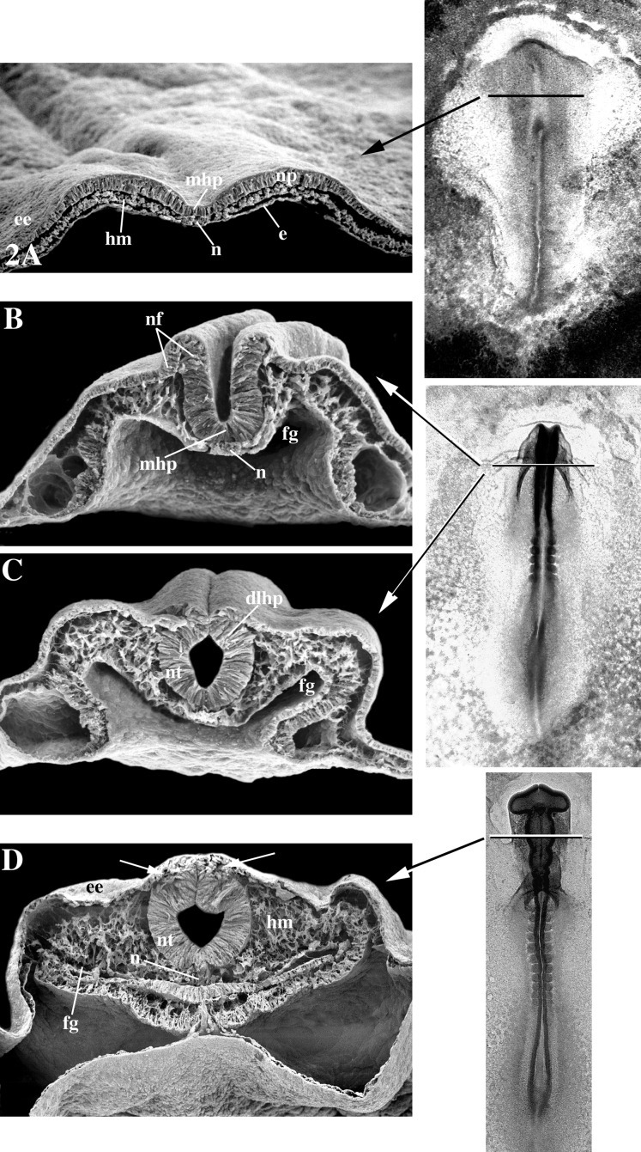
Neurulation (the formation of neural tube)
Neural plate
stage
Neural groove stage
Neural tube stage
Definitive neural tube stage
Developmental Dynamics, Volume: 221, Issue: 2, Pages: 117-145, First published: 02 May 2001, DOI: (10.1002/dvdy.1144)
Notes:
Orientation whole‐mounts (3 insets to right) and transverse sections (A–D) viewed with scanning electron microscopy at various periods during primary neurulation of chick embryos at approximately the future mesencephalon level (level of transverse lines in whole mounts; B and C are derived from the same level of two embryos, one at the neural groove stage (B) and the other at the incipient neural tube stage (C). A: Flat neural plate stage during shaping and early bending. Furrowing of the neural plate within the median hinge point has occurred. B: Neural groove stage. C: Incipient neural tube stage. Note that the neural folds are in contact with one another but not yet fused. D: Definitive neural tube stage. Note that the neural folds have largely fused forming the roof of the neural tube, neural crest (arrows) and mid‐dorsal epidermal ectoderm. dlhp, dorsolateral hinge point; e, endoderm; ee, epidermal ectoderm; fg, foregut; hm, head mesoderm; mhp, median hinge point; n, notochord; nf, neural fold; np, neural plate. Modified from Schoenwolf (2001).
IF THIS IMAGE HAS BEEN PROVIDED BY OR IS OWNED BY A THIRD PARTY, AS INDICATED IN THE CAPTION LINE, THEN FURTHER PERMISSION MAY BE NEEDED BEFORE ANY FURTHER USE. PLEASE CONTACT WILEY'S PERMISSIONS DEPARTMENT ON PERMISSIONS@WILEY.COM OR USE THE RIGHTSLINK SERVICE BY CLICKING ON THE 'REQUEST PERMISSIONS' LINK ACCOMPANYING THIS ARTICLE. WILEY OR AUTHOR OWNED IMAGES MAY BE USED FOR NON-COMMERCIAL PURPOSES, SUBJECT TO PROPER CITATION OF THE ARTICLE, AUTHOR, AND PUBLISHER.

Slide 16
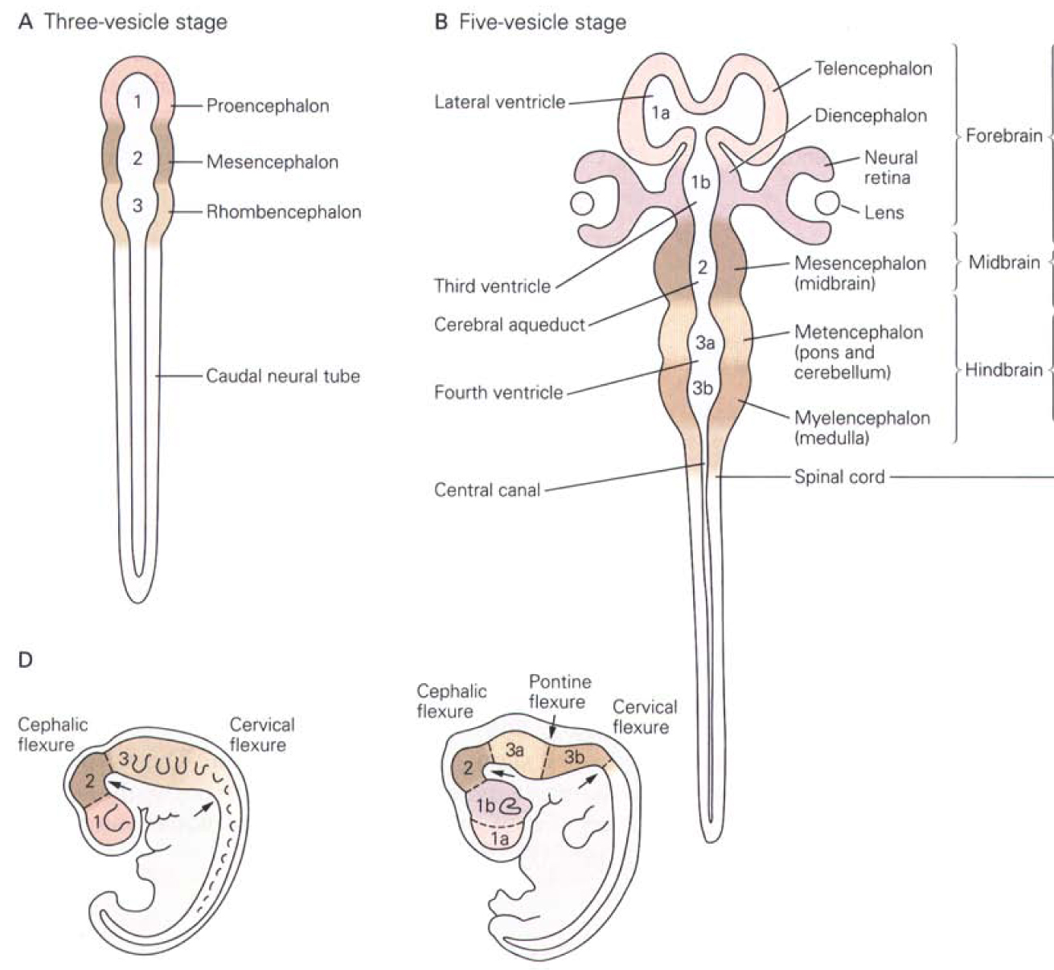
Formation of brain vesicles
Notes:
Differential growth results in formation three vesicles→ five vesicles
The anterior segment of the neural tube forms 1) the forebrain (or prosencephalon), 2) the midbrain (or mesencephalon) and, 3) the hindbrain (or rhombencephalon). The prosencephalon gives rise to the telencephalon (that will give rise to structures such as the cerebral cortex, basal ganglia, hippocampus, etc…) and the diencephalon (that gives rise to the thalamus, hypothalamus, and retina ). Note that the retina, thus, develops as an out-pocketing of the neural tube. The mesencephalon gives rise to the midbrain nuclei (e.g. superior colliculus). The rhombencephalon gives rise to the metencephalon which gives rise to the pons and cerebellum, and the myelencephalon that gives rise to the medulla.
The spinal cord also has subdivisions: cervical, brachial, thoracic, lumbar, sacral spinal cord
16

Slide 17
Formation of brain vesicles
Telencephalon: cerebral cortex basal ganglia, hippocampus
Diencephalon: retina, thalamus, hypothalamus.
Mesencephalon: midbrain
Metencephalon: cerebellum, pons
Myelencephalon: medulla oblongata
Notes:
Differential growth results in formation three vesicles→ five vesicles
The anterior segment of the neural tube forms 1) the forebrain (or prosencephalon), 2) the midbrain (or mesencephalon) and, 3) the hindbrain (or rhombencephalon). The prosencephalon gives rise to the telencephalon (that will give rise to structures such as the cerebral cortex, basal ganglia, hippocampus, etc…) and the diencephalon (that gives rise to the thalamus, hypothalamus, and retina ). Note that the retina, thus, develops as an out-pocketing of the neural tube. The mesencephalon gives rise to the midbrain nuclei (e.g. superior colliculus). The rhombencephalon gives rise to the metencephalon which gives rise to the pons and cerebellum, and the myelencephalon that gives rise to the medulla.
The spinal cord also has subdivisions: cervical, brachial, thoracic, lumbar, sacral spinal cord
17

Slide 18
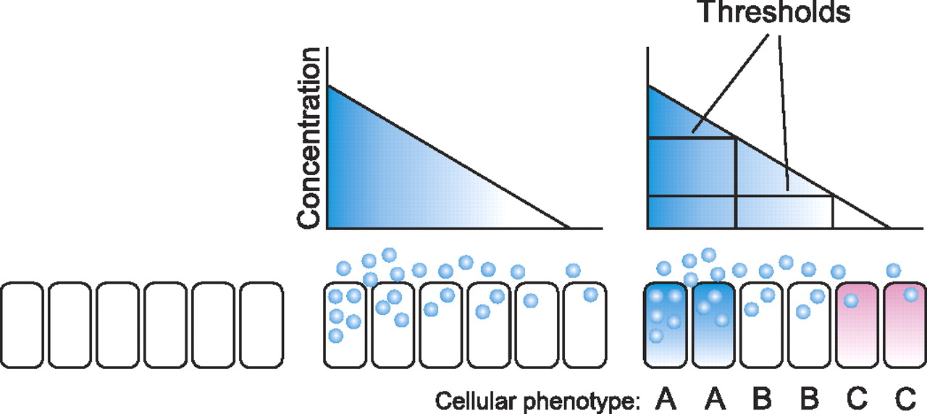
How does it work?
The idea of positional information and positional value
Lewis Wolpert
Late 1960’s
French Flag Model: Cell fate is specified in a cell position-dependent manner by localized production of a morphogen. Depend on their distance from the source, cells experience different concentration of morphogen, resulting in distinct cell phenotypes.
French flag model: Positional instructions are transported from cell to cell in a single, organized direction. Those positional instructions vary in concentration across the cells and dictate each cell’s fate
Notes:
Lewis Wolpert : ideas of positional information and positional value: molecular signals and internal cellular responses to them that enable cells to do the right thing in the right place during embryonic development. The essence of these concepts is that there is a dedicated set of molecules for spatial coordination of cells, identical across many species and across different developmental stages and tissues. The discovery of Hox gene codes in flies and vertebrates has largely vindicated Wolpert's positional-value concept, while identification of growth-factor morphogens in many species has supported the concept of positional information ( In 1988 Christiane Nüsslein-Volhard discovered the first morphogen, the protein bicoid, in fruit flies (Drosophila melanogaster) that is responsible for pattern formation.
French flag model (van den Brink Physiol Rev 2007; 87: 1343-1375). Undifferentiated cells (left) can choose between three different cell fates (blue, white, or red). Cell fate is specified in a cell position-dependent manner by localized production of a morphogen (middle). Depend on their distance from the source, cells experience different concentration of morphogen, resulting in distinct cell phenotypes.
Morphogens and the establishment of gradients: Although morphogens act in a graded manner through tissues, this is mostly not through simple diffusion of a soluble protein. For example sonic hedgehog (Shh) signaling protein is covalently linked to a palmitate and a cholesterol group. These hydrophobic modifications play an important role in the regulation of the range of Hedgehog signaling in a tissue. Similarly Wnts are palmitoylated. It is also important to realize that in reality combinations of various morphogens and their antagonists generate much more complex patterns.

Slide 19
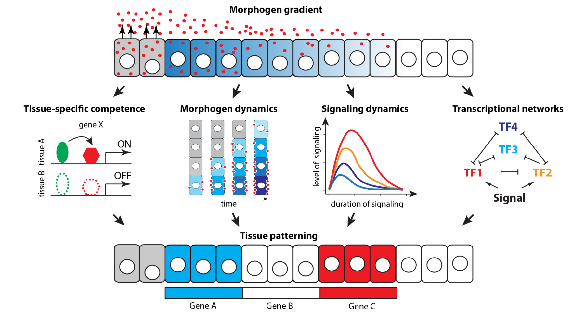
An updated view…
Notes:
The tissue specificity of morphogen signalling was first recognized in classical embryological experiments in which the response to transplants of morphogen producing tissue was shown to depend on the receiving cells. This property has been dubbed competence, and depends on the epigenetic state of the receiving cells, which determines the accessibility of regulatory elements of target genes, and the transcription factors present in the receiving cells that act as cofactors or contributory transcriptional effectors. Since both transcription factor expression and the regulatory element accessibility are controlled by prior developmental events, this mechanism links the morphogen response to the history of a cell.

Slide 20
Key points
Neural patterning is controlled by secreted extracellular signaling molecules that spread over variable distances across neural tissue.
Signals are interpreted by cellular signaling cascades and intrinsic transcriptional networks resulting in the establishment of differential gene expression.
Patterning of the developing nervous system starts early and becomes more refined over time (e.g. secondary signaling centers)
Notes:
Neural patterning is controlled by secreted extracellular signaling molecules that spread over variable distances across neural tissue (RA, Shh, wnt, BMP, TGFbeta,)
Signals are interpreted by cellular signaling cascades and intrinsic transcriptional networks resulting in the establishment of differential gene expression ( same signaling molecule can induce different effects -BMPs and Wnts initially inhibit neural induction but are required for the formation of dorsal neural tissue)
The reiterated action of these signals at different AP and DV levels is sufficient to account for most CNS patterning and regionalization
Break up slide-its too complicated….

Slide 21
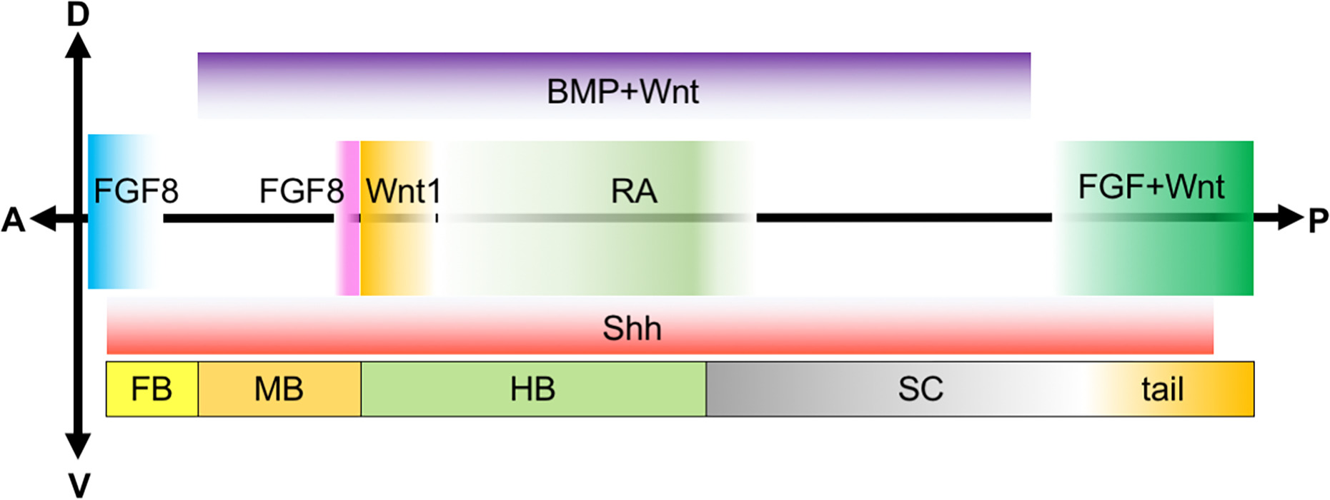
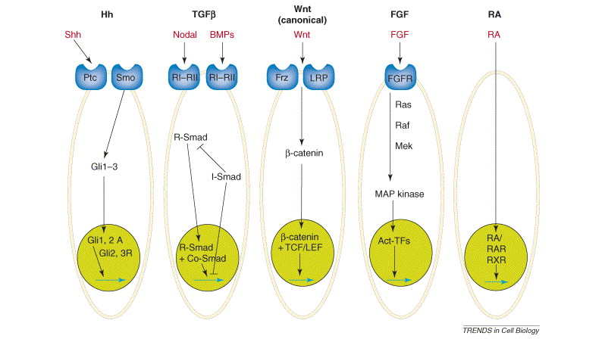
The molecular players
Notes:
Neural patterning is controlled by secreted extracellular signaling molecules that spread over variable distances across neural tissue (RA, Shh, wnt, BMP, TGFbeta,)
Signals are interpreted by cellular signaling cascades and intrinsic transcriptional networks resulting in the establishment of differential gene expression ( same signaling molecule can induce different effects -BMPs and Wnts initially inhibit neural induction but are required for the formation of dorsal neural tissue)
The reiterated action of these signals at different AP and DV levels is sufficient to account for most CNS patterning and regionalization
Break up slide-its too complicated….

Slide 22
Anterior-posterior patterning of the CNS: KNOW THE MECHANISMS
Wnts, FGFs and RA posteriorize the neural plate
Wnt gradient creates signaling center such as midbrain-hindbrain boundary (MHB)
A hallmark of clustered Hox genes is the direct correlation between their linear arrangement along the chromosome, and the timing and A-P boundaries of their expression during early development –this is termed co-linearity.
Hox transcription factors impart A-P positional identity and neural identity in developing hindbrain

Slide 23
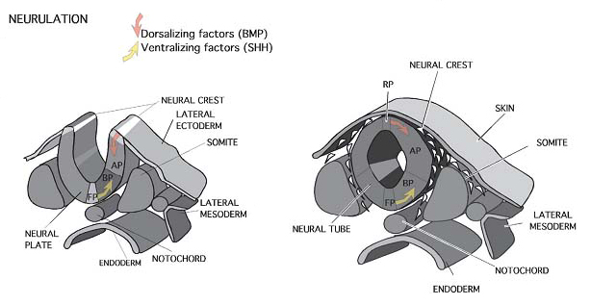
Dorsal-ventral patterning of the developing CNS
FP: floor plate
RP: roof plate

Slide 24
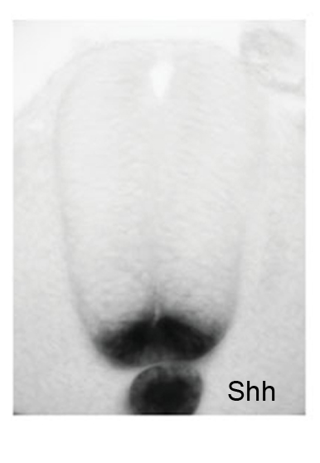
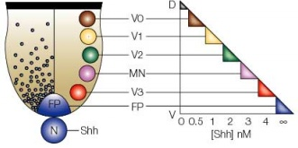
Sonic hedgehog signaling controls ventral pattering of the developing CNS
Floor plate (FP)
Notochord (N)
Secreted Sonic hedgehog (Shh) from the notochord and the floor plate establishes a Shh concentration gradient along the dorsal-ventral axis.
SHH concentration gradient informs class I and class II homeodomain protein expression, which in combinatorial fashion determines ventral progenitor identity and neuronal fate.
Notes:
Ventral fate –notochord and floor plate:
The initial ventral patterning signal is provided by the notochord, a mesodermal cell group, which early on underlies the midline of the neural plate and later underlies the midline of the neural tube. This signaling center induces a second signaling center, the so- called floor plate of the neural tube. The ventralizing activity of notochord and the floor plate is mediated by (Shh). Secreted Shh from the notochord and the floor plate establishes a Shh concentration gradient along the dorso-ventral axis.

Slide 25
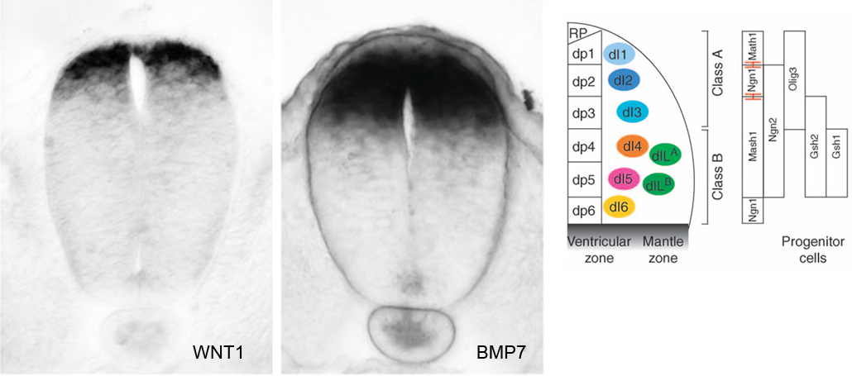
BMP/Wnt signaling controls dorsal pattering of the developing nervous system
Roof plate (RP)
Wnt/BMP concentration gradient informs bHLH protein expression, which in combinatorial fashion determines dorsal progenitor identity and neuronal fate
Notes:
Dorsal fate -roof plate:
The roof plate, a group of cells at the dorsal midline of the closing neural tube, is induced by ectodermal BMP and wnt signaling. Note that it is from this dorsal-most roofplate that the neural crest derives, which gives rise to both neural cells of the peripheral nervous system as well as non-neural structures. The roof plate expresses members of the TGF beta family (BMP4) and wnt family.
In the dorsal spinal cord, six progenitor domains (dp1–6) generate six early born (dI1–6) and two late born (dILA and dILB) dorsal interneurons. Unlike the ventral spinal cord, basic helix–loop–helix (bHLH) transcription factors have a predominant role in patterning progenitor domains. Cross repression between Math1, Ngn1 and Mash1 are essential for delineating boundaries of most dorsal progenitors.

Slide 26
Organizing centers and the patterning of the brain

Slide 27
Signals from organizing centers pattern the brain
Isthmic organizer (IsO): Fgf8→ patterns midbrain-hindbrain
Anterior neural ridge (ANR): Fgf8 → patterns forebrain
Zona limitans intrathalamica (Zli): Shh →patterns nuclei of thalamus

Slide 28
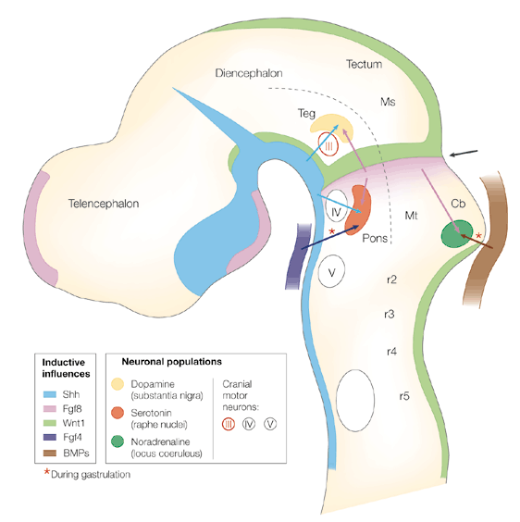
Midbrain hindbrain patterning
Cortical hem
Zone limitans intrathalamicia
Isthmic organizer is located at the midbrain/ hindbrain border.
Fgf8 secreted from the isthmic organizer act in concert with dorsal (Shh) and ventral signals (BMPs) to pattern neurons in the midbrain and hindbrain.
Isthmic organizer
Anterior neural ridge
Prechordal
plate
Floor plate
Roof plate
Notes:
Fgf signals (and wnt signals) from the isthmic organizer act in concert with Shh signals from the ventral line to pattern neurons in the midbrain and hindbrain. However, the Isthmic organizer only appears to impart information along the anteroposterior axis, and there are often different structures that develop at the same point along the anteroposterior axis, but at different dorsoventral locations.
For example, r1 gives rise to the cerebellum on the dorsal side and to the pons on the ventral side. The necessary dorsoventral positional information is encoded by non neural BMP signaling (dorsal ectoderm) and Fgf4 signaling (anterior mesoderm) during gastrulation.
Motor neurons of cranial nerve III and dopamine neurons of the tegmentum respond to a combination of Shh and Fgf8.
Serotonin neurons of the pons require early Fgf4 signalling, followed by Shh and Fgf8.
Noradrenaline neurons of the cerebellum require Fgf8 and Bmp4.
Sagittal view of a mouse neural tube at E11, anterior to the left. Secreted factors, (arrows) control neuronal identities originate from the neural plate at the midhindbrain hindbrain border junction (Fgf8) and floor plate (Shh, blue), as well as from non-neural tissues during gastrulation. The arrow indicates the midbrain/hindbrain border. (Cb, cerebellum;; Ms, mesencephalon; Mt, metencephalon; r, rhombomeres; Teg, tegmentum; Tel, telencephalon (Schematic from Wurst & Bally-Cuif (2001) Nature Reviews Neuroscience 2:99-108_

Slide 29
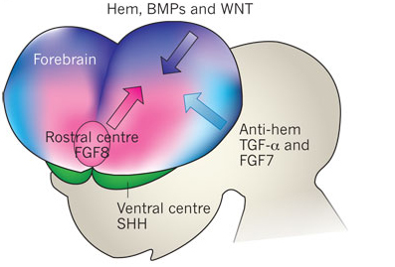
Forebrain patterning

Slide 30
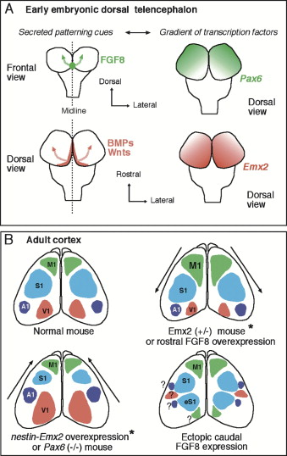
Forebrain patterning
anterior
anterior
posterior
posterior
In addition, afferent input from the periphery e.g. retina during critical time period influences cyto-architecture
Notes:
Patterning centers and graded expression of transcription factors contribute to the specification of the cortical area map.
Fgf signals (Fgf8, Fgf17) from the anterior ridge (becomes later commissural plate) and Wnts and BMPs from the cortical hem establishes a tangential counter gradients of two homeodomain-containing transcription factors Pax6 and Emx2.
With high levels of Pax6 at anterior level and high levels of Emx2 at posterior level. Note that the distinct spatial domains of expression of Pax6 and Emx2 depend on cross-repressive interactions. This graded expression of Pax6, Emx2, (and other transcription factors), imparts positional or “area” identities to cortical progenitors.
For example motor areas develop in the Pax6+ anterior region, and visual areas (V1) in Emx2+ posterior regions.
Afferent input from the periphery during a critical period influences cyto-architecture and neuronal function. For example rerouting of retinal input into the auditory pathway (ablating the inferior colliculus) in neonatal ferrets reprograms the auditory cortex to process visual information. Another example is the grafting of visual cortex tissue into the somatosensory cortex. The somatosensory input (whiskers) induces a barrel-like cellular pattern in the grafted visual cortex tissue, which is normally only seen in the somatosensory cortex.

Slide 31
Tips for Colantuoni and Doetzlhofer:
Combine their material when studying. There’s significant overlap!
Start with big picture then go to detail: Organizers, Competence, French Flag model, Gastrulation, Neurulation, Neural Induction, Neural Patterning (A-P and D-V patterning)
*Know specific morphogens, cell/molecular mechanisms, which organizers mediating the patterning/neural induction during each phase of development

Slide 32
Blackshaw: Neuronal Cell Fate Specification

Slide 33
Features of the Waddington model
time
Cell type
1. Development is a unidirectional process.
2. Development involves progressive fate restriction.
3. Extrinsic, intrinsic and random factors can control fate specification.
4. Final cell fates are stable and do not interconvert.

Slide 34
Differentiation in multiple dimensions
BMP2/4/7
RA
Cell fate = RA+BMP+Shh
x
z
y
Shh
Temporal patterning
t
Neurons born

Slide 35
Progressive developmental restriction in the CNS
Region A
Regionalization
Region B
Neurogenesis
begins
Time
Early-born
cells
Late-born
cells
Neurogenic
progenitor
Neuron A
Neuron B
Glia
Neuron D
Neuron C

Slide 36
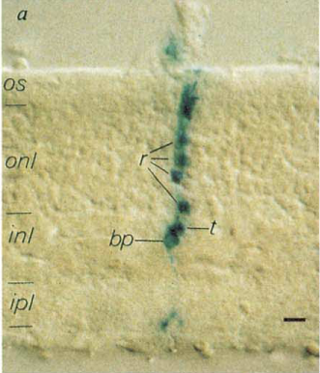
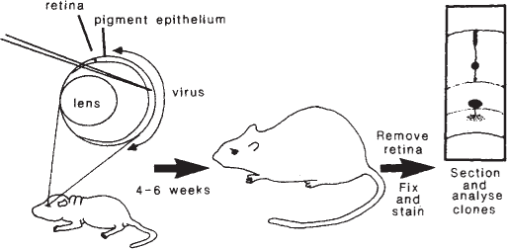
Radial migration is the rule, however
Radial glia
VZ
Postmitotic precursor
Mitotic progenitors
Most neurons and glia are generated locally
Clonal analysis reveals radial migration patterns

Slide 37
Inside-out, outside-in and combinations of both
strategies are used to pack newborn neurons
Cerebral cortex (Inside-out)
1
2/3
4
5
6
Hypothalamus (Outside-in)
LH
PvN
DMH
ArcN
Retina (mixed)
Cone
Rod
BC
AC
GC

Slide 38




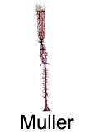

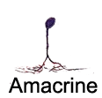
Retinal progenitors pass through a series of
states of developmental competence
E11
birth
P14
Progenitors can’t jump ahead
X
X
Progenitors can’t jump back
Notes:
How do you make this a unidirectional process?
Transcription factor cascade?
Long-term chromatin changes?
Progressive gene silencing (RNAi-mediated)?
Somatic changes (recombination?)

Slide 39
Cortical progenitors are more plastic
Progenitors can jump ahead
2/3
4
5
6
Progenitors can* jump back

Slide 40
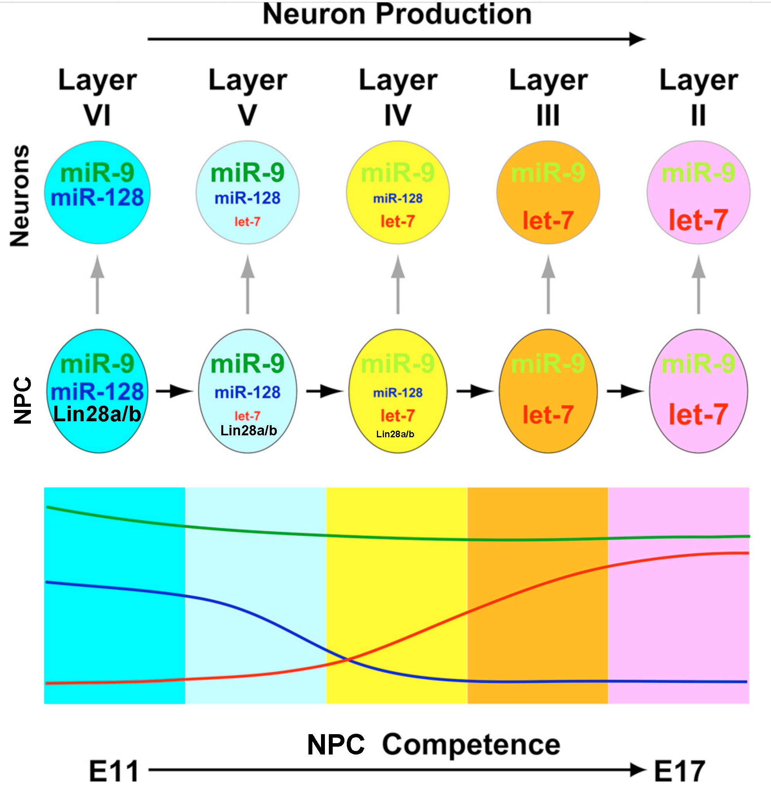
Control of temporal patterning by miRNAs -- mammals
X
Dicer KO
Lin28a/b KO

Slide 41
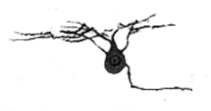

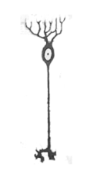
Mode of NPC symmetric and asymmetric division and rate of
neurogenesis change over time
F_{Div}
+
+
F_{Div}
+
F_{Div}

Slide 42
Symmetric vs. asymmetric RPC division
probability changes over time
F_{Div}
+
E12
P0
P5
+
F_{Div}
E12
P0
P5
+
F_{Div}
E12
P0
P5

Slide 43
Neural progenitors are like dynamically loaded dice
6>>5>4
6=5=4<3
6<<5<4<3
Time
3>4>2>1
X
more often than by chance!
3>2=1
2>1>3
New faces= gain/loss of competence

Slide 44
Mode of NPC division and rate of
neurogenesis change over time
F_{Div}
1,2
+
3,4
+
+
5,6

Slide 45
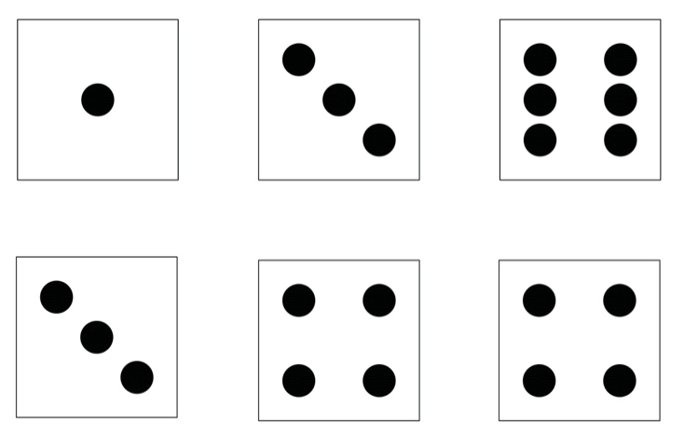
Mode of NPC division and rate of
neurogenesis change over time
F_{Div}
1,2
+
3,4
+
+
5,6

Slide 46

Notch pathway
Delta
Notch
γ sec
NICD
Rbpj
Maml
Rbpj
Hes
Hes
NICD
Notch signaling is regulated by positive feedback
Notch
Delta
N
N
N
N
N
N

Slide 47
Notch-regulated bHLH factors
drive neurogenesis
Neurogenic RPCs
Primary RPCs
Hes
NeuroG/Olig2
NeuroD
N
N
N

Slide 48
Notch signaling and asymmetric cell division
N
N
N
N
Par-3/Par-6/aPKC
Pins/
Gαβγ
Insc
Notch
Numb/PON

Slide 49
Xu: iPSCs in Neuroscience Research
1. iPSC vs. tissue, animal, other in vitro cell models
2. Advantages + disadvantages of iPSC systems
3. Limitations of iPSC systems
4. Advantages and limitations of organoids

Slide 50
Xu last slide
Question 1:
What is the key difference in the origin of embryonic stem cells (ESCs) and induced pluripotent stem cells (iPSCs)?
Question 2:
List three reasons why human iPSCs (hiPSCs) are highly valued for neuroscience research.
Question 3:
Explain one broad application of hiPSCs in translational neuroscience.
Question 4:
Compared with earlier reprogramming methods, what are two major advantages of iPSCs that make them suitable for biomedical research, and what is one ongoing challenge in using iPSCs to model human disease

Slide 51
Worley: Immediate Early Genes
Immediate early genes are genes that are rapidly transcribed and expressed at the most upstream level in response to stimulation (environmental/cellular), and they make up cell autonomous response to evoke downstream network response of homeostatic regulation and to maintain/mediate potentiation of strong synapses.

Slide 52
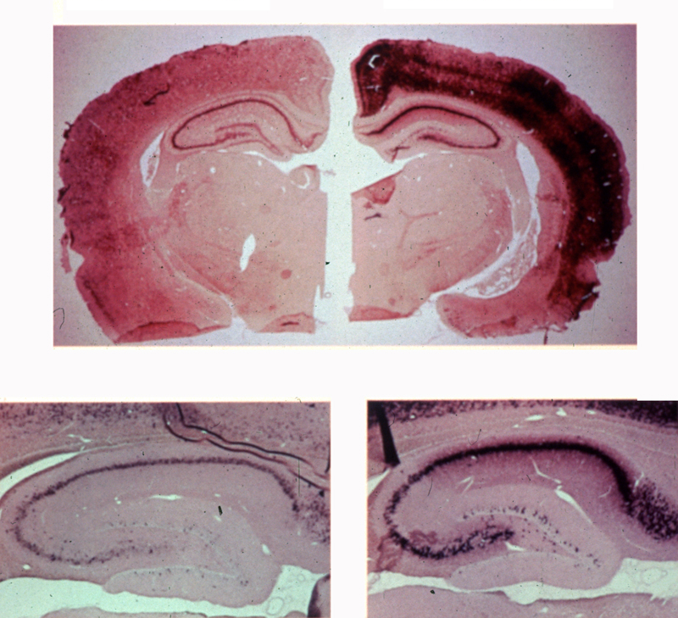
Arc mRNA is Induced During Behavior
Individual cage
1 hr Exploration
Steward et al 1998, 2001

Slide 53
Arc Protein Interacts with Endophilin and Dynamin
Chowdhury et al 2006 Neuron

Slide 54
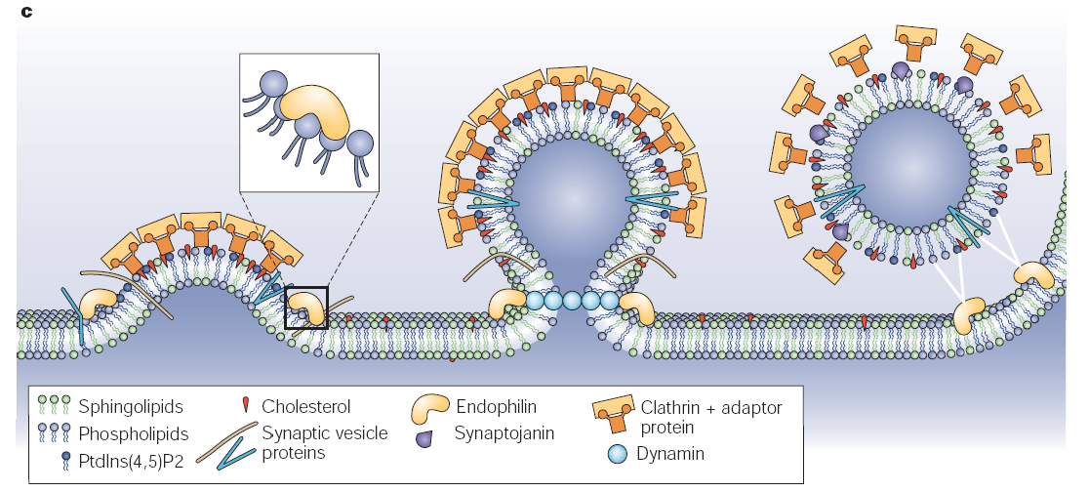
Arc Interacts with Components of the Endocytic Machinery
Modified from Rohrbough & Broadie Nature Reviews Neuroscience 2005
Arg3.1
Notes:
Add Arc xx
Endophilin and Dynamin also mediate the recycling pool of synaptic vesicles

Slide 55
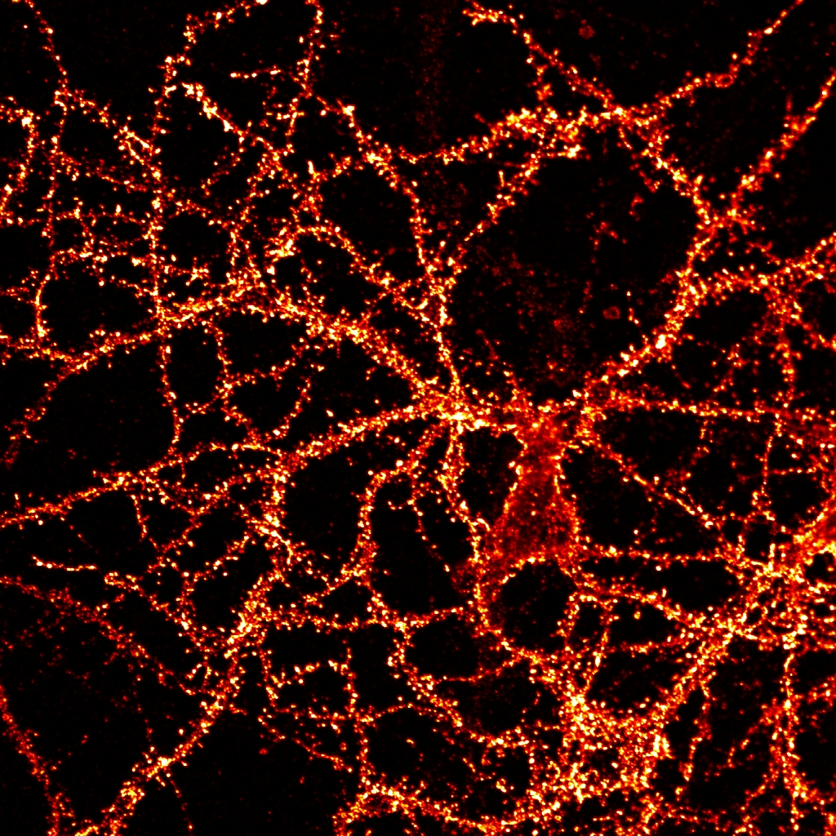
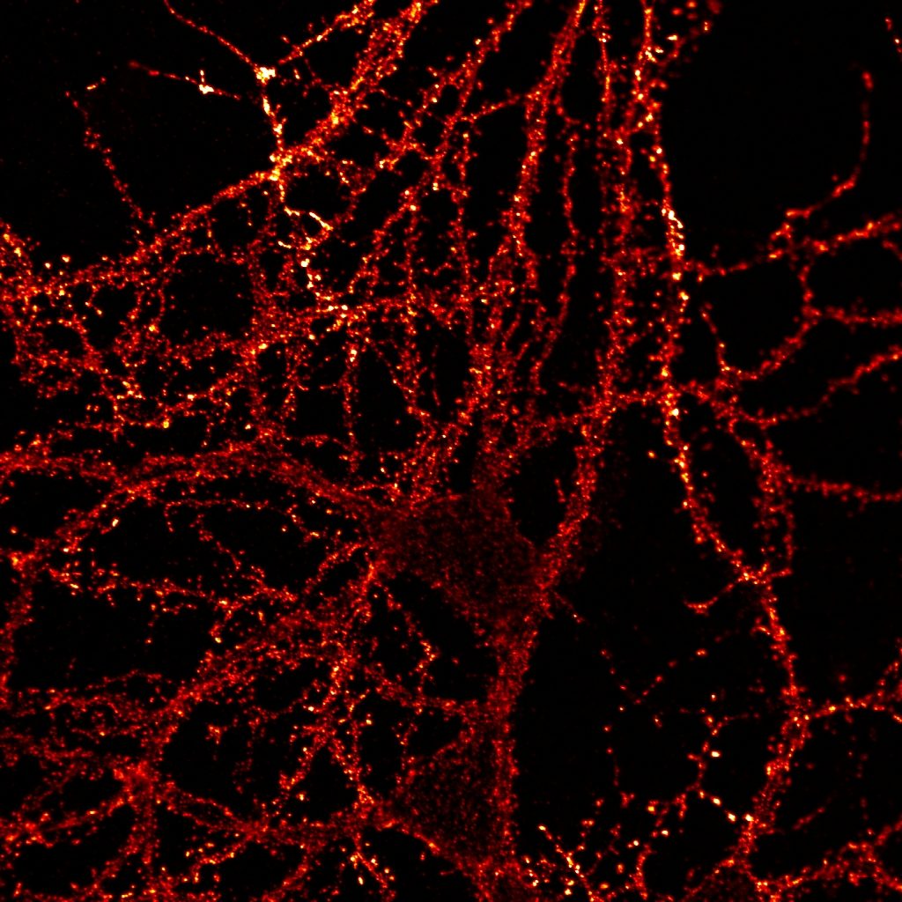
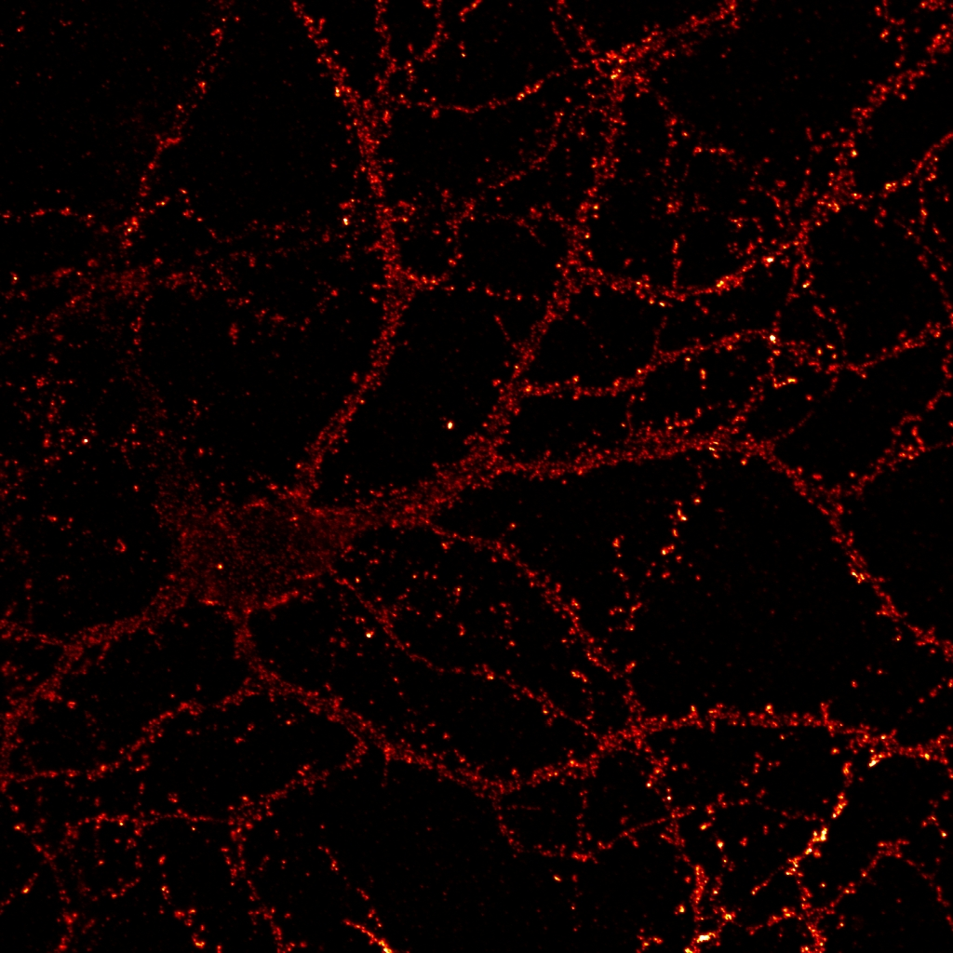
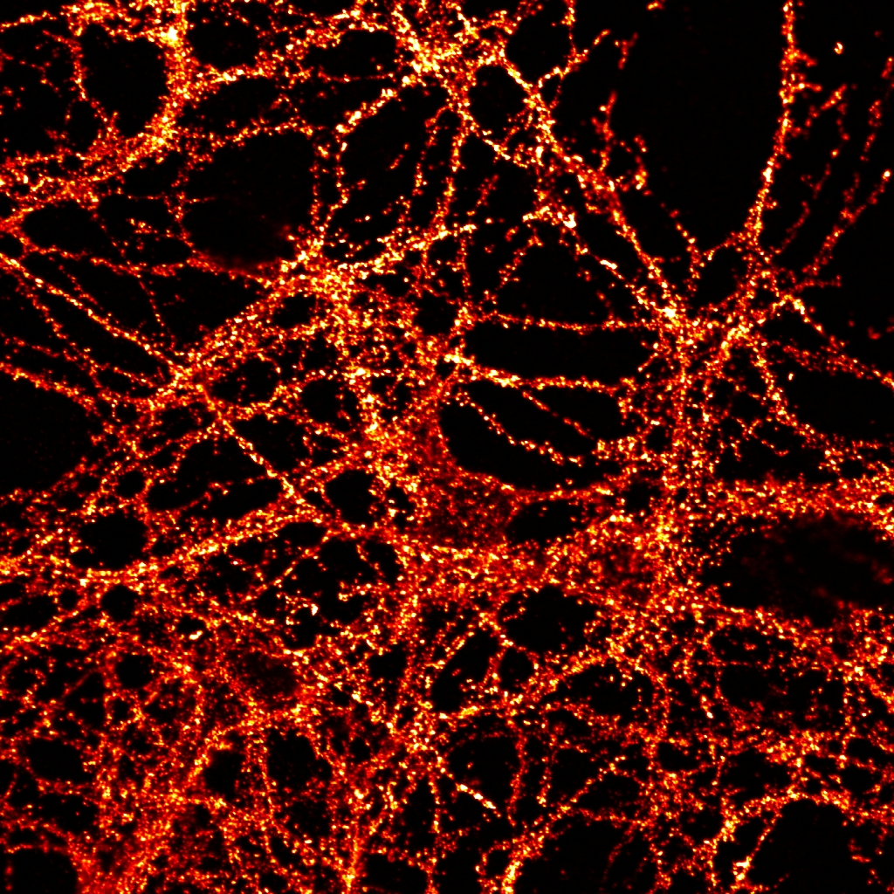
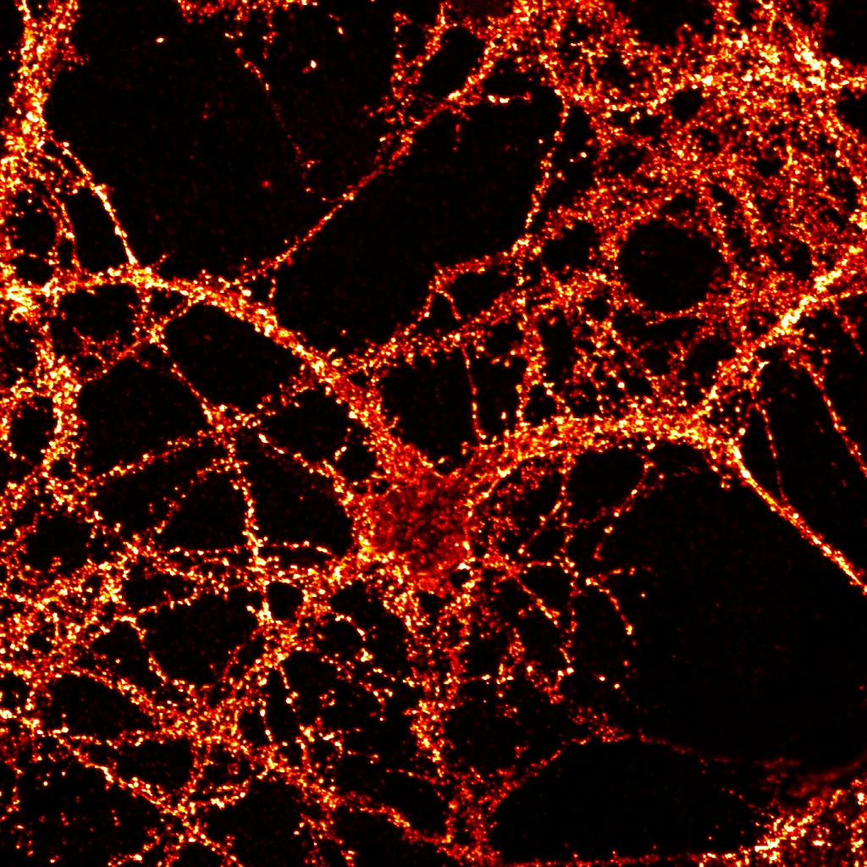
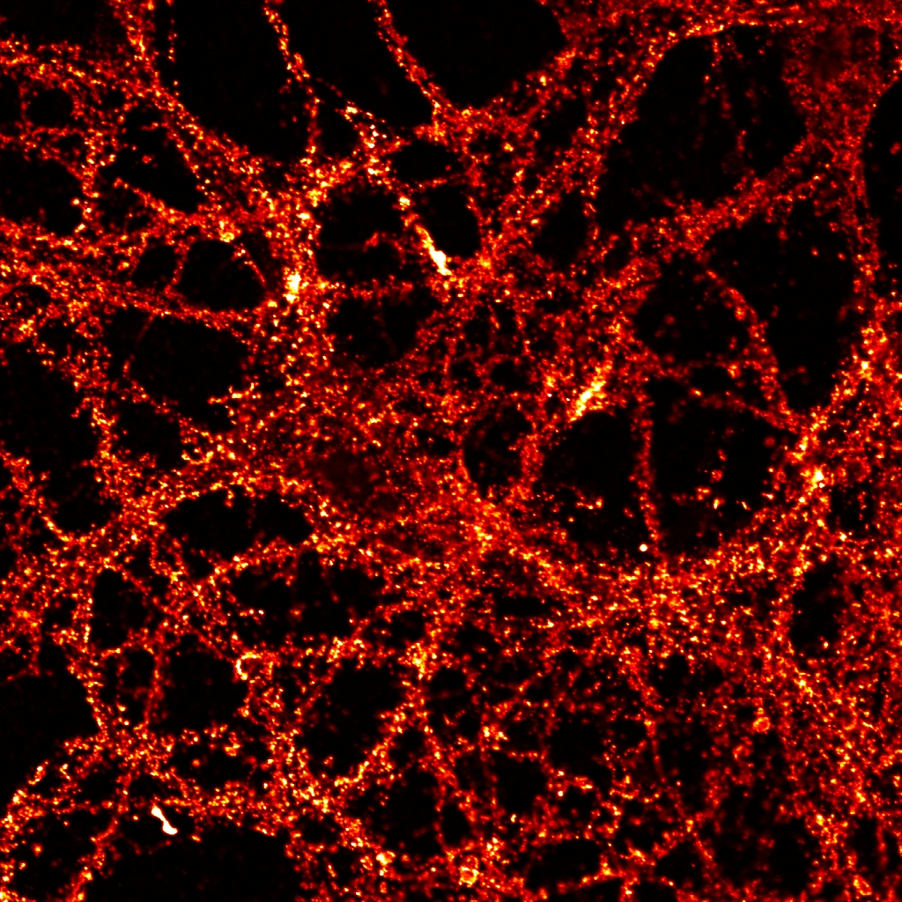
Homeostatic adaptation of surface AMPARs is
Abolished in Arc KO Neurons
Surface GluR1 – Wt (TTX)
Wt (Untreated)
Wt (Bic)
Homeostatic scaling:
Neuronal response to chronic/persistent excitatory/inhibitory input to scale postsynaptic response back towards basal levels (up or downscaling). It is a form of plasticity mediated in an AMPAR-dependent manner.
Surface GluR1 – KO (TTX)
KO (Untreated)
KO (Bic)
D
Shepherd 2006 Neuron
Notes:
TTX blocks Nav, expect postsynaptic neurons to upregulate AMPAR to attempt to increase EPSP response.

Slide 56
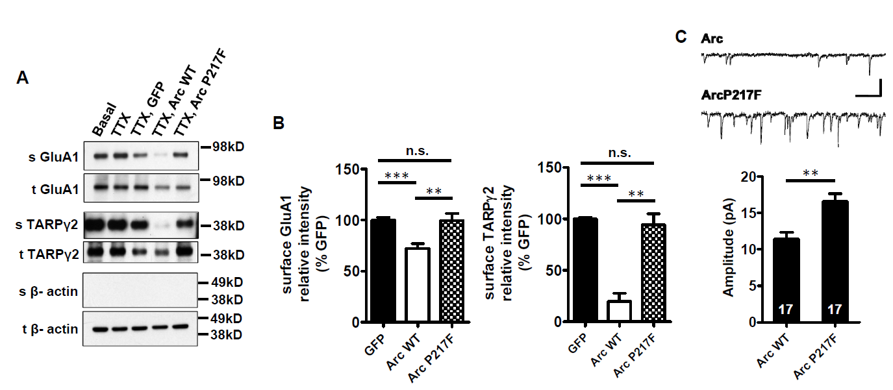
Arc binding site is required for trafficking of TARPγ2 and AMPA receptor during homeostatic scaling

Slide 57
Presenilin 1 co-immunoprecipitates
with Arc from brain
Wu J., et al. Cell 2011
Notes:
57
Jing Wu determined that Arc co-Ips selectively with the N-terminal fragment of processed presenilin.
Detergent (0.5% Triton X 100) lysates of S2 fraction from wt and Arc ko forebrain were precipitated with antibody for Arc, and associated proteins were assayed by western blot using the indicated antibodies. Lysates were also probed (Input). Note that PS1 N-terminal fragment (NTF) co-IPs with Arc.

Slide 58
Arc mediates activity-dependent
Aβ Generation
Low Activity
High Activity
Aβ
Aβ
BACE1
Endocytic Recycling
Pathway
Endocytic Recycling
Pathway
BACE1
PS1
(γ-secretase)
PS1
(γ-secretase)
Endo2/3
Dyn
APP full-length
Arc/Arg3.1
APP β-CTF
Neural
Activity
Aβ peptide
Neuronal Dendrite
Wu J., et al. Cell 2011
Notes:
Studies supported a model in which Arc recruits gamma secretase to vesicles that traffic APP.

Slide 59
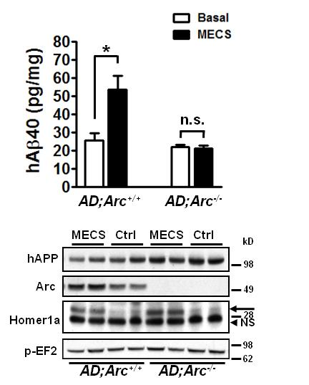
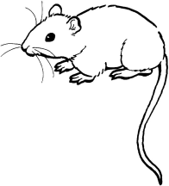
Activity-Dependent β-Amyloid generation is
abolished in Arc ^{-/-} mice.
In vivo MECS
AD mice: APPswe; PS1ΔE9.
Wu J., et al. Cell 2011
Notes:
Another unexpected finding from studies of Arc is that it mediates activity-dependent increases in the generation of Aß.

Slide 60
NPTX2 Clusters AMPA Receptors
NPTX2
N
N
1
3
4
1
2
2
3
4
N
PKC-α
NSF
EPH R/Ephrin
C
C
C
N
PDZ
PDZ
N
N
PDZ
PDZ
N
PDZ4
PDZ5
PDZ6
PDZ7
C
CC
CC
CC
CC
PDZ4
PDZ5
PDZ6
PDZ3
PICK1
PDZ2
C
PDZ7
C
C
C
C
PDZ1
PDZ3
N
PDZ2
GRIP1&2
PDZ1
N
Song and Huganir, Trends Neurosci 2002
Notes:
NPTX2 is a secreted calcium-dependent lectin and distant relative of Neuroligin and agrin. We know the pentraxin domain directly binds AMPA receptors. Early work focused on its ability to induce synapse formation when expressed by heterologous cells at sites of contact with neurons.

Slide 61
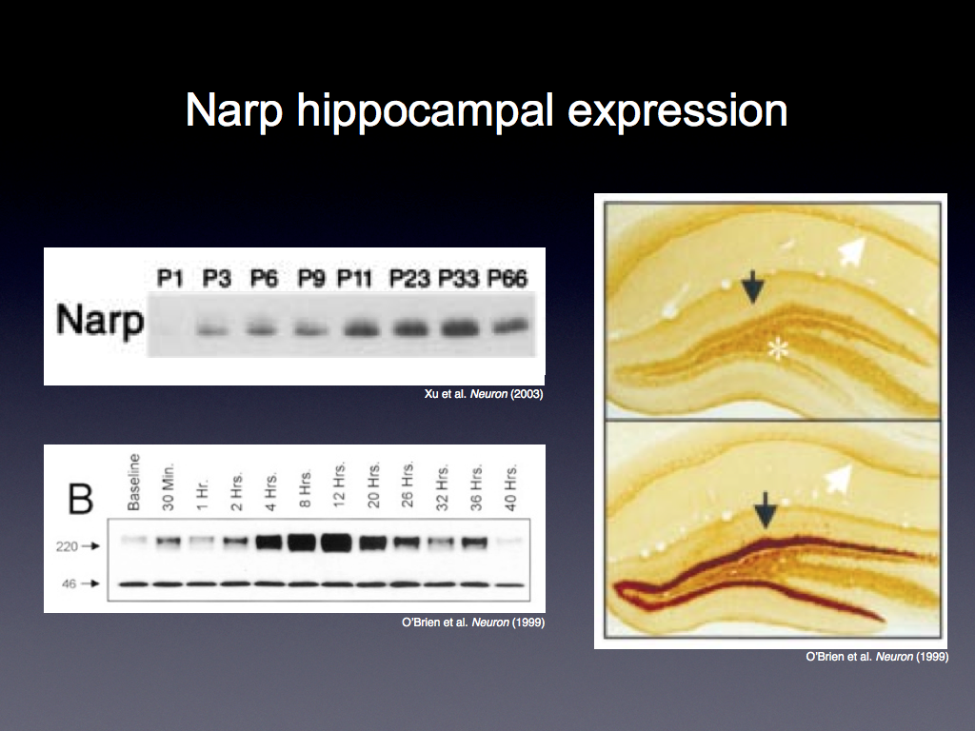
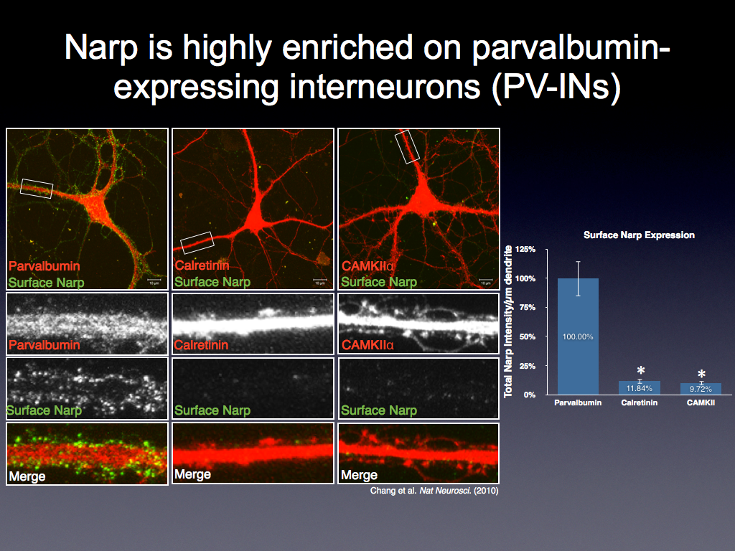
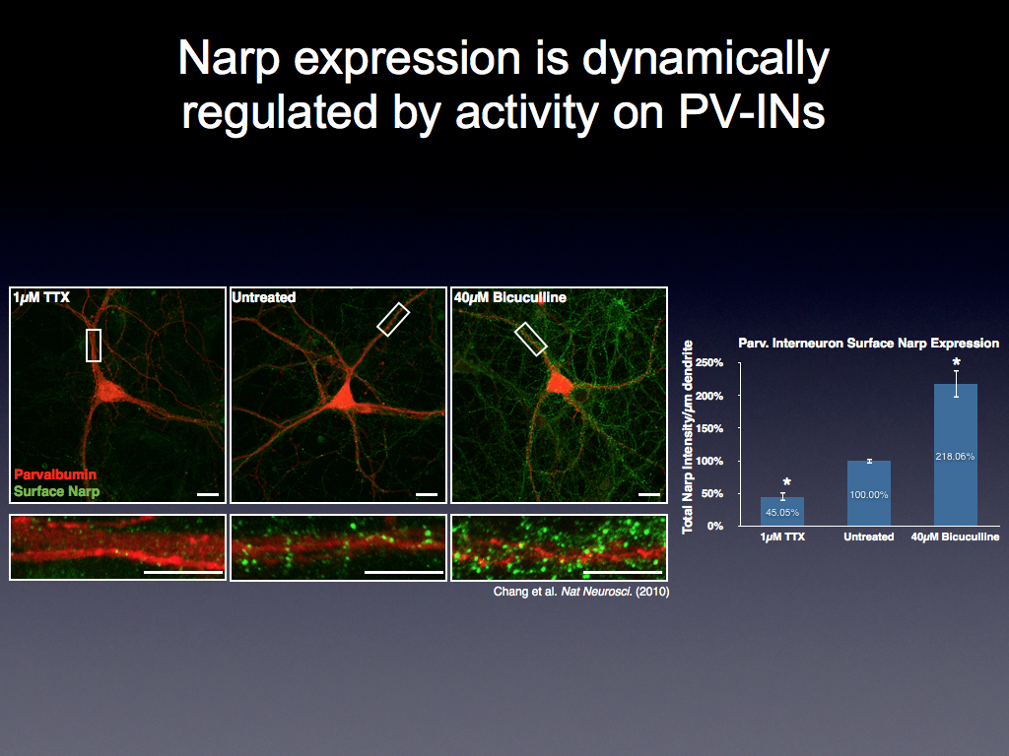
NPTX2 Clusters AMPA Receptors
NPTX2
N
N
1
3
4
1
2
2
3
4
N
PKC-α
NSF
EPH R/Ephrin
C
C
C
N
PDZ
PDZ
N
N
PDZ
PDZ
N
PDZ4
PDZ5
PDZ6
PDZ7
C
CC
CC
CC
CC
PDZ4
PDZ5
PDZ6
PDZ3
PICK1
PDZ2
C
PDZ7
C
C
C
C
PDZ1
PDZ3
N
PDZ2
GRIP1&2
PDZ1
N
Chang et al Nature NS 2010
Notes:
As activity increases, NPTX2 expression on PV interneurons increases, and with this there is an increase in the synaptic localization of AMPA receptor GluA4.

Slide 62
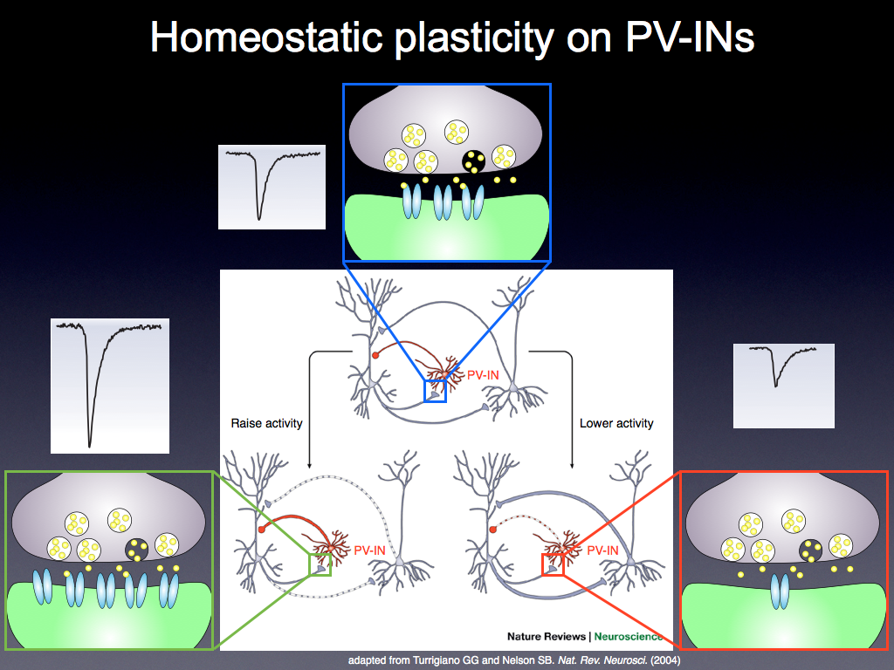
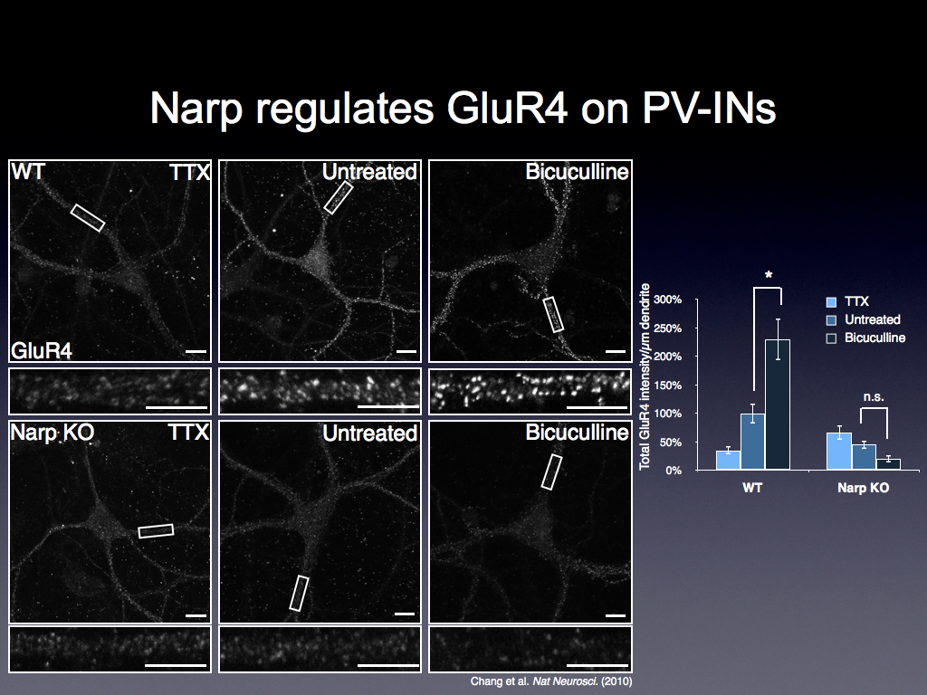
Chang et al Nature NS 2010
Notes:
Compare WT versus NPTX2 KO.

Slide 63
NPTX2
GluA4
NPTX2
NPTX2
GluA4
GluA4
Notes:
WE come then back to the concept of homeostatic scaling in this case pyramidal neurons reset activity by engaging the inhibitory interneuron circuit.

Slide 64
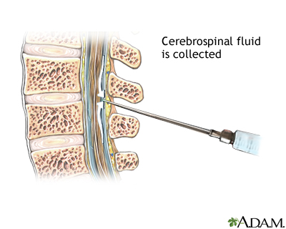



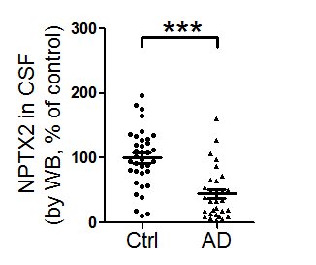
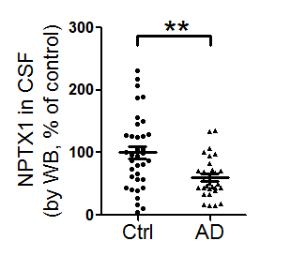
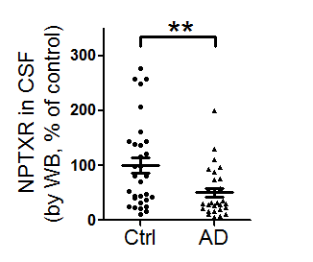
NPTX is reduced in AD CSF
Control
AD
Cerebrospinal fluid (CSF)
NPTX2
NPTX1
NPTXR
NPTX2
NPTX1
NPTXR
Xiao et al eLife 2017
Notes:
Consistent with the observed presynaptic secretion of NPTX2, it is detected in the CSF of control subjects. Consistent with the observation that NPTX2 is down-regulated in brain of patients with AD, NPTX2 is reduced in the CSF of subjects with clinical diagnosis of AD.
The fact that NPTX1 and NPTXR are also reduced in CSF but are not reduced in brain suggests that the source of NPTX in CSF is dependent on NPTX2. Of these only NPTX2 is specific to excitatory synapses on PV-interneurons.
All CSF determinations were done blind to diagnosis.

Slide 65
Cycle of Memory Consolidation
A sequential, hierarchical, and circuit-based process
Activity induces cell-specific transcriptional response
Network-dependent increase of signal-to-noise
CSF NPTX2
0 hr
Cell autonomous increase of signal-to-noise
18-24 hr
Arc
Weakens inactive
synapses and
generates Abeta; Arc-NMDAR interaction maintains LTP; local activity creates
“checkpoint”
2 hr
Network reactivation
Shedding
Exocytosis
NPTX2
Strengthen excitatory
synapses on PV-IN,
Scale GluA4 and NMDAR NR2A.
Secretion may be a ‘check point’.
Homer 1a
Activates mGluR to drive weakening of inactive synapses; metaplastically enhances NMDAR signaling
at concurrently active
synapses. Pin1-
”check point”.
6 hr
Notes:
So this is the model of memory consolidation, which is regarded as cyclic process.
Also, this is sequential, hierarchical, and circuit-based process.
Neuronal activity induces cell-specific transcriptional responses.
[Click]
The first responder here is the gene Arc, which can weaken inactive synapses very quickly.
And Arc is also involved in Amyloid beta generation.
[Click]
After a while, the circuit undergoes network reactivation by the action of H1a.
H1a can activate mGluR to drive weakening of inactive synapses;
It also enhances NMDAR signaling at active synapses.
Here, Arc and H1a contribute to cell autonomous increase of signal-to-noise.
[Click]
The next step is by NTPX2 which strengthens excitatory synapses on PV-IN, by clustering the AMPAR.
The process that is network-dependent increase of signal to noise.
[Click]
The trafficking of NPTX2 is important because they undergo exocytosis and shedding into the CSF.
Where we found that NPTX2 level is reduced.
[Click]
So in schizophrenia, the utilization of the memory consolidation is impaired.

